Slide 1




End-to-End Learning from Crowdsourced Labels: A Signal Processing perspective
Hyderabad, India
April 7, 2025
Shahana Ibrahim¹, Panagiotis A. Traganitis², Xiao Fu³, Georgios B. Giannakis⁴
¹Dept. of ECE, University of Central Florida
²Dept. of ECE, Michigan State University
³Dept. of ECE, Oregon State University
⁴Dept. of ECE, University of Minnesota
Acknowledgements: NSF 2128593, 2212318, 2312546, 2007836
Notes:
1
**NOTES: ADD ACKNOWLEDGEMENTS**
The subject is on crowdsourcing and the potential SP tools have on this subject

Slide 2



Relevant links
Learning From Crowdsourced Noisy Labels: A Signal Processing Perspective
https://arxiv.org/abs/2407.06902
LINK TO SLIDES
https://github.com/shahana-ibrahim/Learning-from-Crowdsourced-Noisy-Labels/blob/main/Crowdsourcing_ICASSP25.pptx
https://github.com/shahana-ibrahim/ Learning-from-Crowdsourced-Noisy-Labels

Slide 3
Outline
Motivation and problem statement
Part I: Combining crowdsourced labels
Part II: End-to-end (E2E) learning with crowdsourced labels
Part III: Other aspects of crowdsourcing
Conclusions and open issues

Slide 4


The wisdom of crowds
The parable of the ox (Sir Francis Galton, 1906)
787 people guessed the weight of an ox
Average crowd guess: 1,197 pounds - True weight: 1,198 pounds!
Who wants to be a millionaire – Ask the audience
Q. Can we harness this wisdom in a principled way?

Slide 5
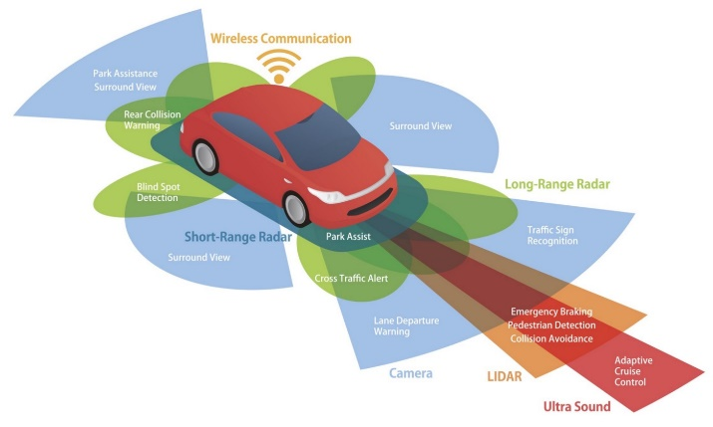












Fusing data versus fusing decisions
Data fusion is costly [Waltz-Llinas’90, Mitchell‘07]
Distributed (generally noisy) decisions [Tsitsiklis’89]
Crowdsourcing vs hierarchical learning
Can benefit from the wisdom of humans
Fuses (un) reliable decisions from annotators
Redundancy is key to discover truth and assess annotator reliability!
Notes:
Sensors have limited power and bandwidth, what motivates fusing decisions over data, and perhaps jointly designed with compression.
We may not have labels, but we can ask agents of the crowd to provide us with labels, and then combine them judiciously. Tsitsiklis designed optimally both local and global classifier. In crowdsourcing, the local detector structure maybe unavailable, just label responses are available.
Hierarchical learning typically assumes that per-agent decisions are reliable, while crowdsourcing can accommodate unreliable decisions.
Thus, annotators will be more generally viewed as unreliable learning models such as human annotators, weak learners, or mobile agents

Slide 6
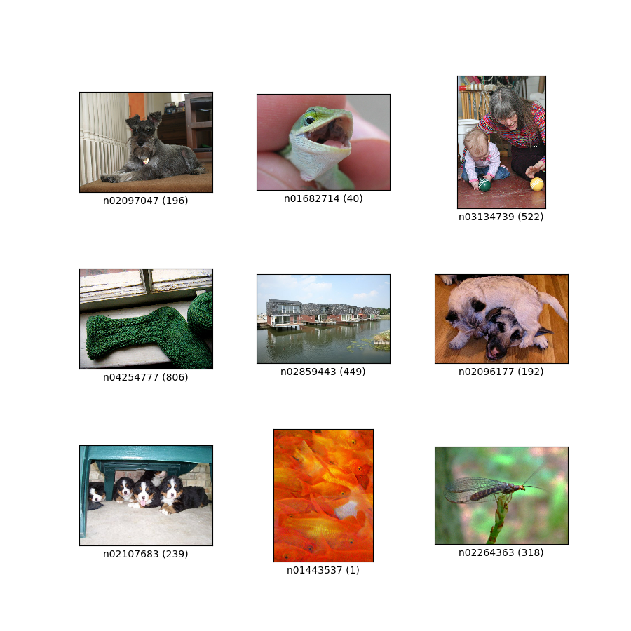
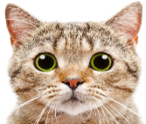
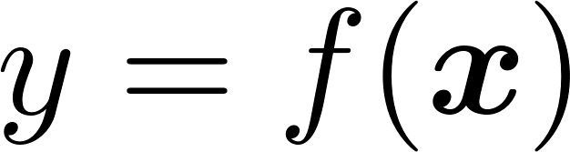



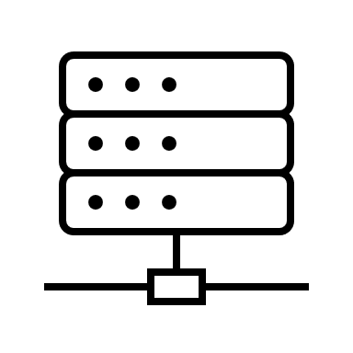

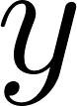
Crowdsourcing in the learning context
Machine learning pipeline
Data
{dog, cat, gecko, … }
Labels
Model training
Machine learning model
No labels, noisy labels or very few labels
Crowdsourcing encompasses weakly supervised,
semi-supervised, self-supervised, transfer learning …
and relies on ensembles of (un)reliable learners
Two major paradigms to learn from crowds
Notes:
Related terms: Unsupervised, semi-supervised, self-supervised or transfer learning, multi-task learning, or meta-learning

Slide 7


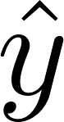
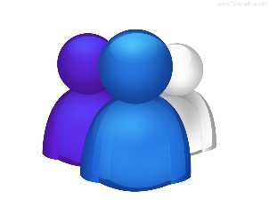


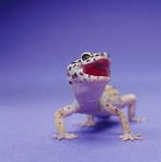
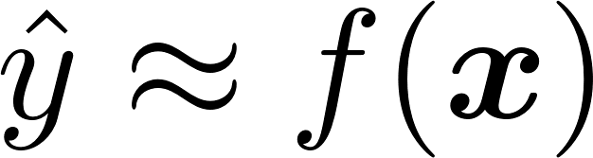
Two-stage: Label denoising followed by learning
Label denoising
Unlabeled data
Crowd
Crowd labels
Estimated labels
cat
cat
cat
cat
elephant
dog
elephant
dog
elephant
dog
tiger
gecko
gecko
gecko
dog
Model training
Machine learning model
Notes:
Under this paradigm the crowd observes data and provides noisy labels. The noisy labels are denoised/fused. The fused labels are then used alongside the data to train a model.

Slide 8

Learning with noisy labels – End-to-end learning
Unlabeled data
Crowd
Crowd labels
cat
cat
cat
elephant
dog
elephant
dog
tiger
gecko
gecko
dog
Model training
Machine learning model
Notes:
Here on the other hand the data and the noisy crowd labels are used directly to train an ML model.

Slide 9
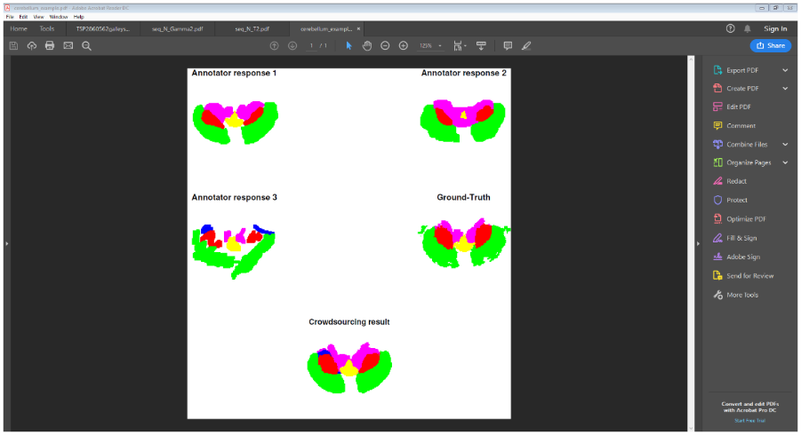
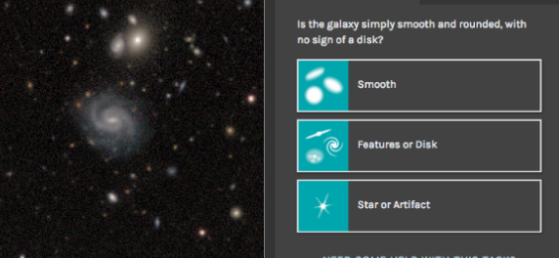
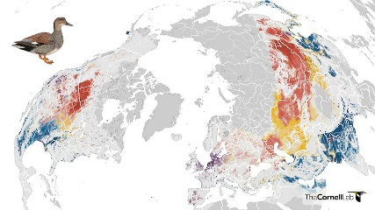
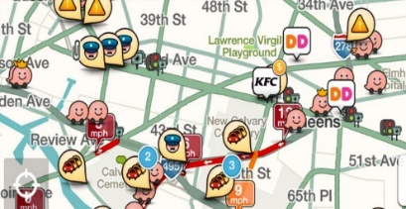



Crowdsourcing across disciplines
Medical image analysis
Citizen Science
Crowdsensing in 5G and 6G
Facilitated via commercial services
Notes:
Labels for image annotation, sentiment analysis, website analysis – Services such as Amazon’s mechanical turk enable crowdsourcing!
Citizen science: Zooniverse, GalaxyZoo, eBird
Crowdsensing like Waze
5G and 6G crowdsensing for wireless comms and networking.

Slide 10
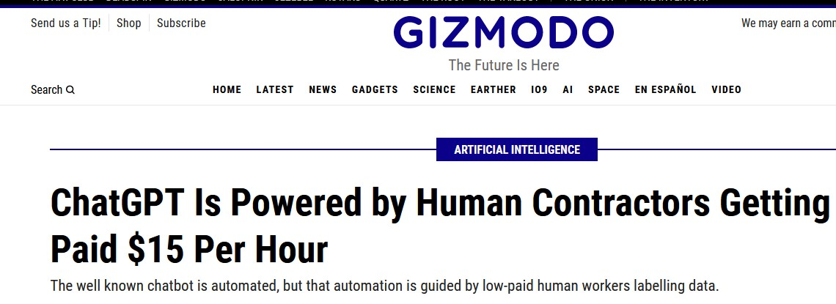
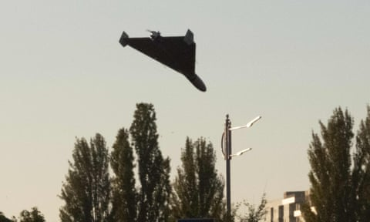
Crowdsourcing: “Hidden” catalyst behind AI tools
Ukrainians used cell phone app to spot deadly
Russian drones and missiles in Crimea
Notes:
ChatGPT and other “AI” tools rely on crowdsourcing to provide answers to queries
GPT stands for "Generative Pre-trained Transformer," a type of AI designed to generate human-like text by predicting the next word in a sentence based on the words that came before it.
Crimean Peninsula was successfully monitored by Ukrainians carrying cell phones to detect small cross-section Russian/Iranian drones or missiles that are hard to detect by Ukrainian radar systems.

Slide 11
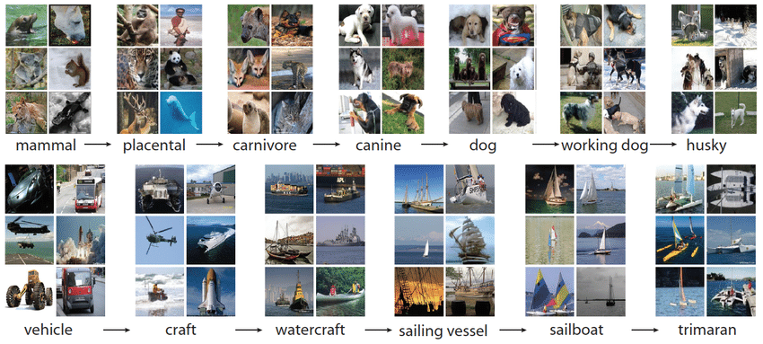
Opportunities and challenges
Opportunities
From unlabeled to labeled datasets
No expert supervision needed
Low-cost and efficient learning
LLM alignment
This Photo by Unknown Author is licensed under CC BY-SA
Challenges
Lack of ground-truth labels
Annotators can be unreliable and even adversarial
Sparsity of responses per annotator
This tutorial:
Crowdsourcing from a signal processing, and machine learning points of view
Statistical learning framework
Notes:
Imagenet is an example of crowdsourcing and creating a labeled dataset!

Slide 12
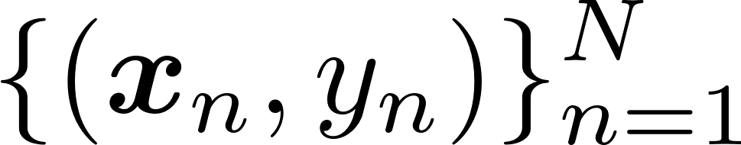
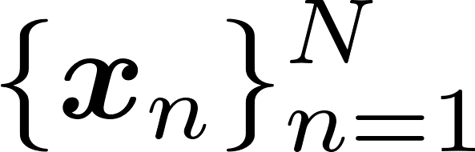
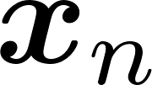
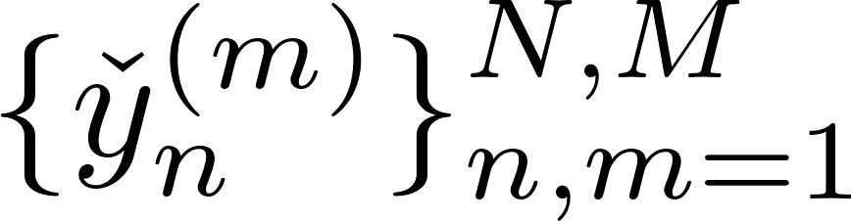
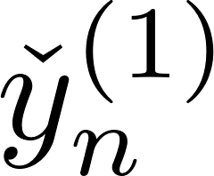
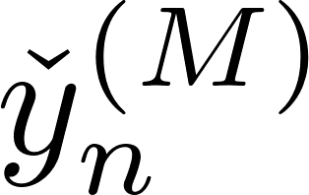
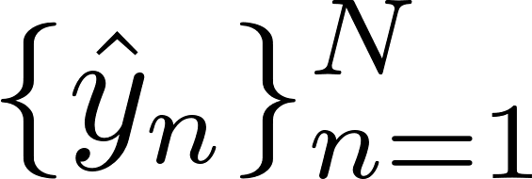
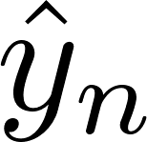
Crowdsourcing for classification
N data , K classes
M annotators observe subsets of
Data
Annotators provide noisy labels
Annotator 1
….
Annotator M
Goal: Given , find
Label fusion
Q1. Which annotators are reliable? Q2. How can we combine (un)reliable answers?
Inference of labels is sought in a “noisy” unsupervised setting!
Notes:
Annotators have access to input data (features) {x_{n}}, but not the fusion center (blind decision setup). It resembles stacking ensembles in ML (assessing proper weight?)
The terms annotators, sensors, agents, users devices, workers will be henceforth used interchangeably.

Slide 13
Outline
Motivation and problem statement
Part I: Combining crowdsourced labels
Majority voting, annotator models, and Expectation-Maximization (EM)
Moment matching methods
Identifiability
Part II: End-to-end (E2E) learning with crowdsourced labels
Part III: Other aspects of crowdsourcing
Conclusions and open issues

Slide 14

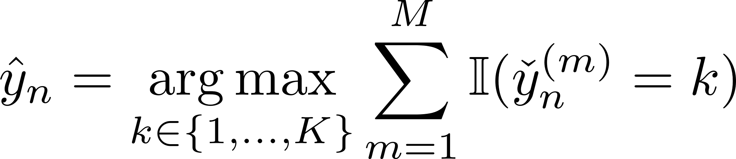
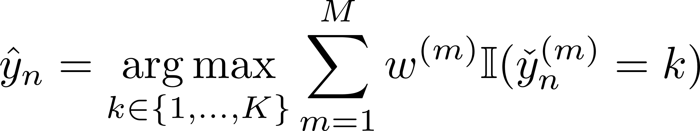
Majority voting or averaging
Simplest solution to crowdsourcing
Per datum n, pick most common answer
Caveat: Majority voting (MV) assumes all annotators are “the same” and “independent”
Q. Can we do better than MV?
A. Yes, by modeling annotator behavior!
Simple extension: weighted MV
Q. How to find weights?
Notes:
Indicator function summands add up votes per class $k$. The winner MV class is selected as the class of the majority
Annotators maintain a steady behavior throughout the dataset. Here shown for classification, but for prediction it corresponds to unweighted averaging (1/M) of annotators’ predictions. Reliability judged by confusion matrices that we will specify later. It is also possible to have weighted MV with weights reflecting reliability parameters per annotator.
Our first annotator model that is presented next, presumes that their responses are independent conditioned on given label.

Slide 15
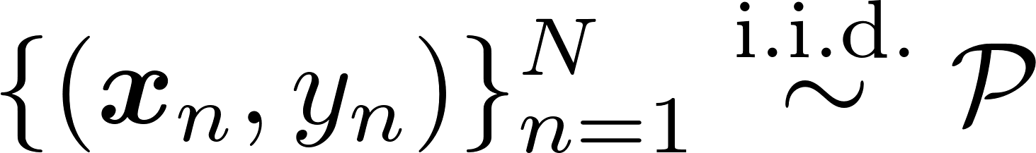

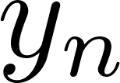
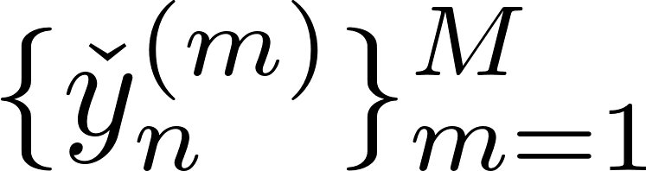
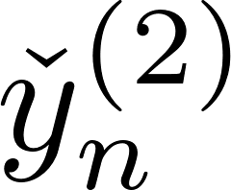
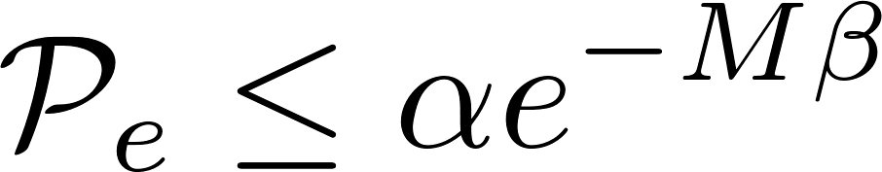
Annotator model with independent responses
Dawid-Skene (DS) data model
Maximum a posteriori (MAP) fusion of annotator labels
(as1) Given ground-truth label , annotator responses are independent
Theorem. Under (as1) there are constants α,β > 0 so that the error probability of the MAP classifier satisfies
Performance
Notes:
Annotators maintain a steady behavior throughout the dataset.
Note the MAP rule in the yellow box looks like weighted MV. In this case the weights are also class conditional Reliability judged by confusion matrices with entries in the sum that are conditional densities.

Slide 16
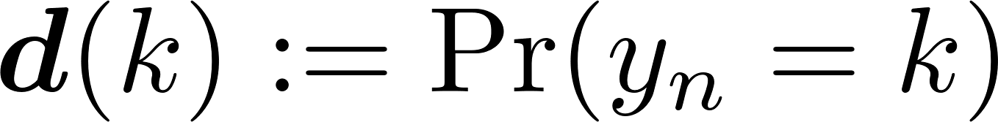
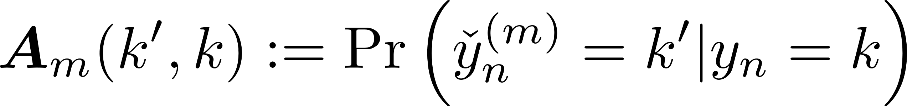
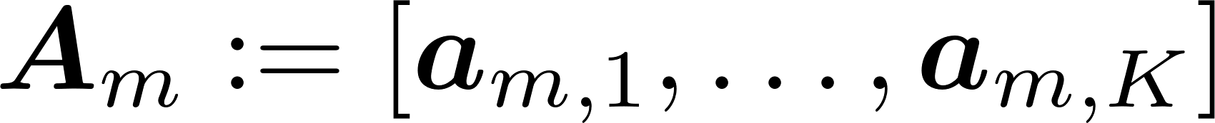
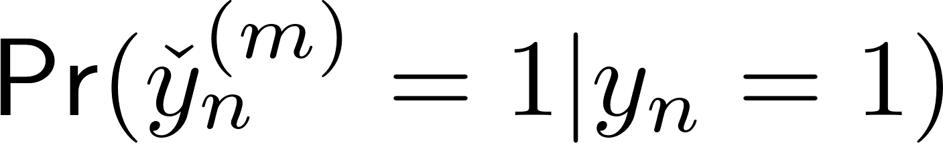
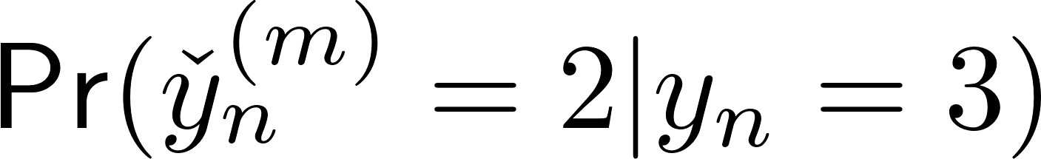
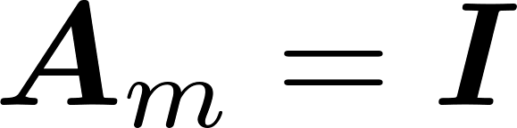
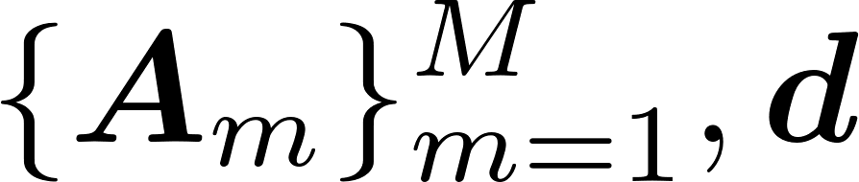

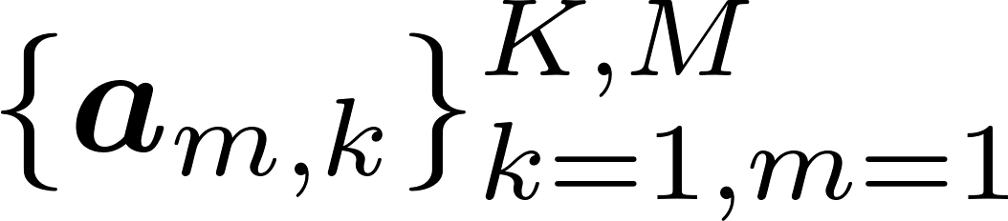
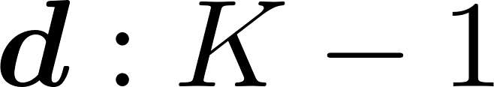
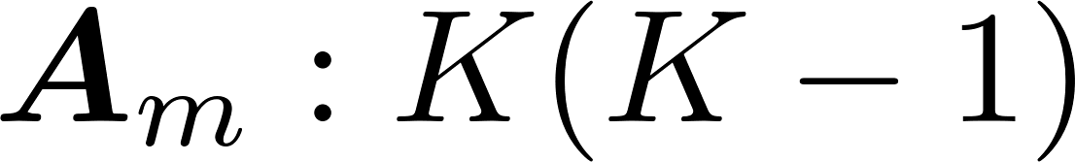
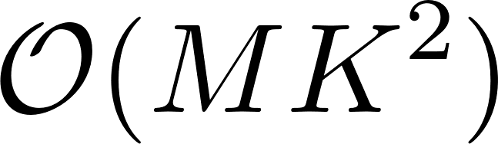
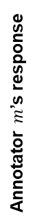
Parametric model
MAP classifier needs and
Confusion matrices
True Label
1
2
3
0.8 | 0.4 | 0.2
0.1 | 0.3 | 0.1
0.1 | 0.3 | 0.7
Error
Correct labeling
1
2
Annotator $m$’s response
3
Ideal annotator
Model parameters must be estimated from annotator responses
lies on a K-1 simplex; and likewise lie on K-1 simplexes
Number of parameters:
and
Total:
Notes:
Actually this is a parametric model since the number of unknown parameters grow with the number of annotators $M$, but the number of observations $N$ helps to have “more equations than unknowns.” Recall that our data are $NM$
Interestingly, the model can be nonparametric for fixed and small $N$, but with $M$ growing to improve performance. In this case, it helps to have simpler models (fewer unknowns)

Slide 17
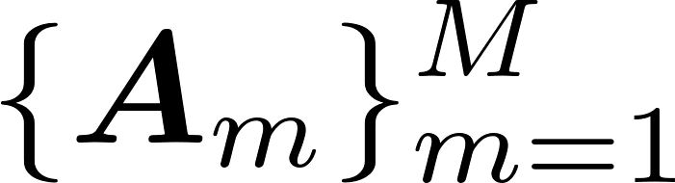
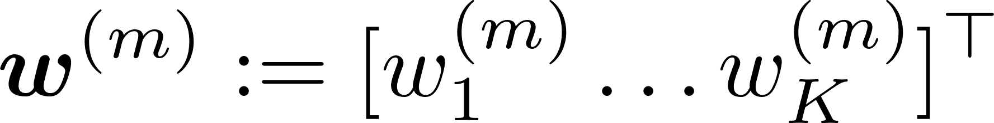
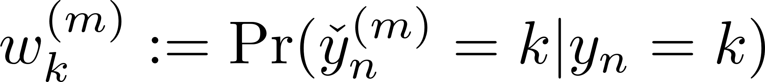
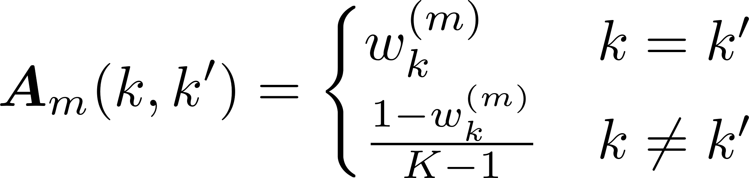
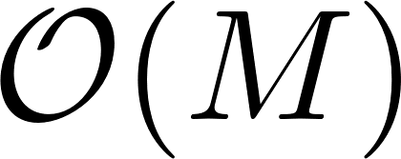
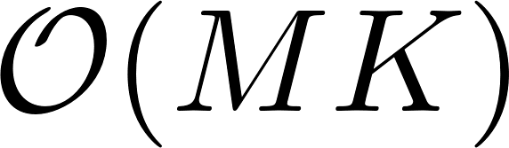
Alternative models
For K=2, we need to estimate 2 parameters per annotator m
Sensitivity
Specificity
Parsimonious models of
One parameter (one-coin) or homogeneous D-S (one unknown per annotator m)
Confusion vector
Significant reduction in the number of parameters and , respectively
More parsimonious however, implies less expressive modeling
Item difficulty can be incorporated [Whitehill et al’09]
Notes:
For the rest we will focus on the Full DS model.
$\alpha^{(m)}$ is the probability of annotator $m$ to be correct

Slide 18
Outline
Motivation
Learning via crowdsourcing
Majority voting, annotator models, and Expectation-Maximization (EM)
Moment matching, and Bayesian methods
Data structure-aware crowdsourcing
Adversary-aware crowdsourcing
Conclusions

Slide 19




Estimating model parameters
Popular for maximum likelihood estimation of parametric mixture models [Dempster-Laird-Rubin’77]
Observations
N latent true labels
Wanted parameters
Wish to maximize
Typically intractable
Use a tractable surrogate pdf q to maximize an expected lower bound with a two-step iteration
S1. Expectation (E-)step
Latent variables updated given observed ones and parameters
S2. Maximization (M-)step
Parameters updated given
estimated latent variables
Nondecreasing sequence of L(ψ)’s converges at least to a stationary point – Initialization is critical
Notes:
Lower bound is tight when q is the posterior of y given Y check.
Basically this is an instance of majorization minimization

Slide 20




EM for crowdsourcing
S0. Initialize
S1. E-step
Bayes rule
S2. M-step
Theorem. If M and N sufficiently large, and EM is properly initialized then correct labels y_{n} are selected w.h.p.
Notes:
Normalization constants $Z’$ and $Z’’$in the last two ratios cancels out.
They don’t necessarily cancel out, but they are straightforward to compute. For the posterior of one datum q_n, the normalization constant is just sum_k q_{nk}

Slide 21







A Bayesian point of view
Parameters of interest d, Α viewed as random
follows a Dirichlet distribution with parameters
Columns of each confusion matrix assumed independent
follow a Dirichlet distribution with parameters
Joint distribution
can be estimated via Gibbs sampling or variational inference (VI)
VI enjoys similar performance bounds to EM [Traganitis-Giannakis’21]
Notes:
MENTION THAT WE’LL GET TO INITIALIZATION IN THE NEXT SLIDE. Given good initialization, error at each iteration can be bounded.
H here collects all confusion matrices.

Slide 22


How about prior information?
Iterative solvers guarantee local optimality – global only with reliable initialization
Both EM and Bayesian approaches can account for a few ground-truth labels, if available
Majority voting (MV)
simple, but reliable?
Resemble
histogram
estimates
Initializing reliability
parameters, but
performance?
MV offers simple initialization, but how about nonuniformly unreliable annotators?
Notes:
[Kim, Ghahramani’12] is an early reference for combining Bayesian classifiers
If ground-truth (meaning reliable) labels are available, collect them in set Y_{r}, and e.g., in EM set q_{nk}= 1(y_{n}=k) for n in Y_{r}

Slide 23


Estimating parameters from annotator statistics
Pairwise statistics of annotator responses
Triplet statistics of annotator responses
PARAFAC/CPD tensor
recoverable from statistics of annotator responses via moment matching
Notes:
We see that wanted parameters show up in all the moments of the annotator responses.
This works under the DS model.

Slide 24




Estimating annotator statistics
Estimates can be readily computed from
M first-order moments
no. of responses from annotator m
second-order moments
third-order moments
Some moments not available
Sparse annotator responses
Heteroskedastic noise

Slide 25






Moment matching with third-order statistics
Available triplet moments
[[\bm A_m\bm D, \bm A_m, \bm A_{m''}]]
Coupled CPD
Sample triplet moments
Relaxation
[[\bm A_m\bm D, \bm A_m, \bm A_{m''}]]
First- and second-order moments can be included
Theorem. If solution relies on ensemble moments, and solution on sample moments, then as
almost surely.
Reduced complexity via orthogonal tensor decompositions [Zhang et al’16]
Notes:
Solved via an ADMM based solver by solving for one variable at a time. Similar to block coordinate descent.

Slide 26





Canonical Polyadic Decomposition in one slide
Data tensor
PARAFAC/CPD Tensor model:
essentially unique
Recoverable up to scaling and common permutation ambiguities
permutation matrix
NP-hard!
Solved via alternating optimization / Gradient descent (GD/SGD) etc.
Off-the-shelf solvers: N-way toolbox, Tensorlab, AO-ADMM, SPLATT

Slide 27

Confusion matrix identifiability
Q. Can we identify from ?
Coupled tensor factorization inherits CPD identifiability guarantees
Recovery of up to common permutation ambiguity
≥3 full rank ‘s required
Additional assumption required to resolve permutation ambiguity
(as2) Most annotators are “better than random”
Diagonally dominant
Caveats
Complexity increases with M
Accurate estimation of third order moments requires a lot of data
Notes:
The scaling ambiguity is solved due to the simplex constraints.

Slide 28













Learning from Third-order Statistics
Tensor methods (e.g., [Traganitis et al., 2018]) estimate
where we have
Annotator $ℓ$
Annotator $j$
Canonical Polyadic Decomposition (CPD) model
Annotator $m$
Identifiability is established using the uniqueness of CPD
if annotators $m,ℓ, j$co-label a sufficient amount of samples, their confusion matrices can be identified.
However, third-order statistics need more samples to estimate accurately
CPD is not easy to compute (NP-hard) [Hillar and Lim, 2013]
Traganitis, P. A., Pages-Zamora, A., and Giannakis, G. B. Blind multiclass ensemble classification. IEEE Trans. Signal Process., 66(18):4737–4752, 2018

Slide 29






Learning from Pairwise Statistics
Pairwise statistics of annotator responses
In matrix form,
where
Second-order statistics need much smaller number of samples to estimate
Model Assumption : Conditionally Independent Annotators
S. Ibrahim, X. Fu, N. Kargas, and K. Huang, “Crowdsourcing via pairwise co-occurrences: Identifiability and algorithms,” NeurIPS, 2019

Slide 30













Learning from Pairwise Statistics
Assume that annotator co-labels with annotators
Annotator
Annotator
Annotator
……
Stack all available pairwise statistics
is observed, but and are unknown
S. Ibrahim, X. Fu, N. Kargas, and K. Huang, “Crowdsourcing via pairwise co-occurrences: Identifiability and algorithms,” NeurIPS, 2019

Slide 31






Learning from Pairwise Statistics
Nonnegative Matrix Factorization (NMF) Model
NMF is generally not unique, but identifiability can be established under some conditions
We hope to leverage separability or sufficiently scattered condition from NMF geometry
identifiability challenge
Separability
1 0 0
Suppose that there exists some indices such that
Identity Matrix
0 0 1
S. Ibrahim, X. Fu, N. Kargas, and K. Huang, “Crowdsourcing via pairwise co-occurrences: Identifiability and algorithms,” NeurIPS, 2019

Slide 32











Learning from Pairwise Statistics
More formally, separability of [Donoho and Stodden, 2003] means that has a diagonal matrix as its submatrix; there exists such that
Unit vector
columns of
on the
projected
convex hull of
rows of
to prob. simplex
Gram–Schmidt-like algorithms exist for NMF under separability:
successive projection algorithm (SPA)
[Araújo et al., 2001, Gillis and Vavasis, 2014, Fu et al., 2015]
Intuitively, if is taller, the chance of having separability is higher

Slide 33









Identifiability Result
Theorem 1 [Ibrahim et al., 2019]
Under the assumption satisfies separability, there exists a
greedy algorithm to learn the true confusion from the model
Separability
1 0 0
columns of
on the
Index identification task
rows of
projected
convex hull of
to prob. simplex
0 01
The problem boils down to estimating the vertices of the simplex formed by
the columns of observed matrix
S. Ibrahim, X. Fu, N. Kargas, and K. Huang, “Crowdsourcing via pairwise co-occurrences: Identifiability and algorithms,” NeurIPS, 2019

Slide 34









A Closer Look at The Assumption
What does it mean by “ satisfies separability”?
Consider annotators
True Label
1
2
3
X | 0 | X
0 | 1 | 0
X | 0 | X
Correct labeling
1
1 0 0
Annotator $m$’s response
2
Confusions
0 1 0
3
0 0 1
is an expert for class 2
Specialized annotators exist → separability holds
S. Ibrahim, X. Fu, N. Kargas, and K. Huang, “Crowdsourcing via pairwise co-occurrences: Identifiability and algorithms,” NeurIPS, 2019

Slide 35



Identifiability Result
Theorem 1 [Ibrahim et al., 2019]
Under the assumption satisfies separability, there exists a
greedy algorithm to learn the true confusion from the model
Wisdom of the Crowd
It was shown that when there are approximate specialized annotators exists, near-separability holds
confusion matrix can be identified using Gram-Schmidt iterations
A fast algorithm called MultiSPA is designed leveraging successive projection algorithm (SPA)
[Araújo et al., 2001, Gillis & Vavasis, 2014, Fu et al., 2015]
S. Ibrahim, X. Fu, N. Kargas, and K. Huang, “Crowdsourcing via pairwise co-occurrences: Identifiability and algorithms,” NeurIPS, 2019

Slide 36


Identifiability Result
Does more annotators help? [Ibrahim et al., 2019]
Number of annotators increases means that we have more rows in
Takeaway: Having sufficiently large number of annotators helps in identifiability
S. Ibrahim, X. Fu, N. Kargas, and K. Huang, “Crowdsourcing via pairwise co-occurrences: Identifiability and algorithms,” NeurIPS, 2019

Slide 37


Enhanced Identifiability Guaranteed Approach
In the previous approach, we construct
for each annotator
What if for some annotators, the model is not identifiable?
Coupled NMF
Available pairwise statistics
Idea: find a feasible solution that fits whatever data available
Can be realized via fitting the below with simplex constraints
How does this criterion identify the model parameters?
S. Ibrahim, X. Fu, N. Kargas, and K. Huang, “Crowdsourcing via pairwise co-occurrences: Identifiability and algorithms,” NeurIPS, 2019

Slide 38







Towards More Realistic Conditions
A concept from NMF theory, sufficiently scattered condition (SSC) [Huang et al., 2014], helps!
Class expert condition
Rows are sufficiently spread in the simplex
1 0 0
SSC of
0 0 1
More specifically, sufficiently scattered condition on implies that the rows are sufficiently spread such that a second-order cone can contain inside the conic hull spanned by , i.e.,
In an NMF model , if both factors satisfy SSC, the model is identifiable upto a permutation ambiguity [Huang et al., 2014]
More relaxed condition compared to separability;
More rows in helps in satisfying SSC

Slide 39




Towards More Realistic Conditions
How does SSC improve the identifiability conditions?
Idea:
If both matrices satisfies SSC, the model is identifiable
Then, if is available, is identifiable through least squares arguments ( )
SSC of
No rows need to be very close to unit vectors
No experts are required, reasonably good annotators are enough
, where
S. Ibrahim and X. Fu. ‘‘Crowdsourcing via annotator co-occurrence imputation and provable symmetric nonnegative matrix factorization’’, ICML, 2021

Slide 40

Towards More Realistic Conditions
Proposition 1 [Ibrahim et al., 2021]
Under the assumption satisfies the SSC,
we can learn
Even if there are no class experts,
the model parameters via
Available pairwise statistics
In case of missing blocks of pairwise statistics, an explicit imputation (matrix completion) gives rise to symmetric NMF problem;
This leads to a faster, convergence guaranteed algorithm [Ibrahim et al., 2021]
S. Ibrahim and X. Fu. ‘‘Crowdsourcing via annotator co-occurrence imputation and provable symmetric nonnegative matrix factorization’’, ICML, 2021

Slide 41


Empirical Results
Noisy labels from
workers
Bluebird Dataset
Web Dataset
Model Identifiability
CNMF
Classification Error (%)
TREC Dataset
Dog Dataset
No Model Identifiability
Methods guaranteeing model identifiability consistently performs well

Slide 42


















Two-stage Approach: Key Takeaways
DS model is one of the influential models in crowdsourcing; several variants have been proposed
DS model identifiability has been extensively studied using several approaches
Identifiability of the noise models is often a key performance indicator.
Sample (annotator label) complexity
is also a key consideration when
selecting an algorithm in practice
Moment-based methods offers
high label-efficiency
high computational
efficiency
Model identifiability
Challenges:
not exploiting data features
error propagation
conditional independence
Ground-truth labels
Features
Data
Crowdsourced labels
Label Integration
Annotator reliability
(confusion) parameters
Integrated labels
Downstream
learning
Downstream
inferred labels

Slide 43


Other algorithms
For K=2, second-order moments (inter-annotator covariance) are enough!
Sensitivity and specificity estimated via eigendecomposition [Parisi et al’14, Jaffe et al’14]
Second-order moments sufficient for one-coin model [Karger et al’11, Ghosh et al’11, Dalvi et al’13, Ma et al’18]
Generalization. Constrained optimization with w = [w₁ … w_{M}] capturing annotator reliability
d: loss; e.g.,
r(w): regularization; e.g., for sparsity
alternating minimization
Minimax conditional entropy [Zhou et al’12]
Maximum margin MV [Tian-Zhu’15] - resembles SVM
Notes:
Generalization offers a flexible model – Loss function can readily handle continuous and categorical variables; regularizer choices can account for e.g., smoothness and sparsity.
Minimization is carried out alternatingly. Per iteration $i$ we are given $w^{(i)}$ and update the label estimate as
${\hat y_n}^(i) = argmin_{y_n} \sum_{m=1}^M w_m^(i) d(y_n,\check{y_n})$
Price paid for flexibility is no optimality or quantifiable performance for learning – recall that EM and VI attempt to solve for the MAP classifier with unreliable labels, and enjoy asymptotic optimality.

Slide 44




Crowdsourcing with dependent data
For several datasets dependencies (e.g., correlations) can be known or estimated
Sequentially dependent data emerging due to dynamics
Spatially dependent data due to spatially evolving processes
Data dependencies can be described by a graph
Graphs are induced by networks (e.g., brain) or real networks (e.g., power grid)
Q. How can we incorporate such domain knowledge?
A. Encode dependencies in
EM and MM algorithms for sequential data [Traganitis-Giannakis’22, Marinnan et al’24]
Hidden Markov Models (HMMs)
Approximate EM algorithm for graph data [Traganitis-Giannakis’22]
Hidden Markov Random Field (HMRF)
Bayesian and optimization-based approaches for sequential data [Nguyen et al’17,Simpon-Gurevych’19, Sabetpour et al’21]
P. A. Traganitis and G. B. Giannakis, "Unsupervised Ensemble Classification with Sequential and
Networked Data," IEEE Trans. on Knowledge and Data Engr., pp. 5009-5022, Oct. 2022.
Notes:
These dependencies may be known or may be estimated fairly easily
Time varying phenomena: Some measurements at time t-1 may be related to measurements at time t. etc. Data that lie on a graph may capture spatial phenomena, such as traffic in adjacent roads or cellular connectivity in nearby spots.
Also graph dependencies can encode various networks, such as data gathered from communication networks or citation, brain and communication networks

Slide 45
Outline
Motivation and problem statement
Part I: Combining crowdsourced labels
Part II: End-to-end (E2E) learning with crowdsourced labels
E2E learning with EM
Deep learning-based E2E learning
Part III: Other aspects of crowdsourcing
Conclusions and open issues

Slide 46





End-To-End (E2E) Learning
Ground-truth Labels
Features
Data
[Raykar et al., 2010]
[Rodrigues & Pereira, 2018]
[Khetan et al., 2018]
[Tanno et al., 2019]
[Li et al., 2020]
[Chen et al., 2020]
[Chu et al., 2021]
[Wei et al., 2022]
Crowdsourced labels
E2E learning
Annotator reliability
(confusion) parameters
Downstream
inference
E2E crowdsourcing incorporates features to jointly tackle label integration and downstream learning
If the goal of the E2E learning is to train a classifier, E2E systems design a loss function such that
The goal of the E2E learning is to learn corresponds to the true-label classifier
additional model parameters, e.g., annotator confusion parameters

Slide 47





End-To-End (E2E) Learning
LabelMe Dataset
Music Dataset
E2E learning approaches
Classification Error (%)
CIFAR10 Dataset
Classification Error (%)
FashionMNIST Dataset
Two stage approaches
E2E methods in general perform much better
Key research questions:
How to understand the performance of E2E crowdsourcing?
How to enhance the performance with principled design?

Slide 48






E2E learning via maximum likelihood and EM
Given the dataset , consider the joint likelihood
True-label classifier
A commonly used assumption: Annotator confusions are not data dependent
Confusion Matrix
[Li et al., 2021, Rodrigues & Pereira, 2018, Tanno et al., 2019]
Goal : learn
and

Slide 49






E2E learning via maximum likelihood and EM
All the learnable parameters
Classifier function
parameterized by
E-Step
The expected value of the complete log-likelihood
M-Step
Like the EM designed for DS model
Several variants have been proposed incorporating different function classes
logistic regression classifier [Raykar et al.,2010]
neural network classifier [Rodrigues & Pereira, 2018]
conditional random field [Rodrigues et al., 2014]
Estimating by maximizing

Slide 50





Deep learning with Crowd Layer
Annotator’s confusion
True label predictor
Goal : learn
and
To estimate the model parameters, the following criterion is considered
[Rodrigues & Pereira, 2018]
Indices of observed labels
Constrained set
Neural network function class

Slide 51
















Coupled Cross Entropy Minimization (CCEM)
E2E learning criterion [Rodrigues & Pereira, 2018]
Learning loss
[Rodrigues & Pereira, 2018]
[Tanno et al., 2019]
[Li et al., 2020]
[Chen et al., 2020]
[Chu et al., 2021]
[Wei et al., 2022]
Features
Cross entropy loss

Slide 52





Model identifiability under CCEM
Issues of model identifiability also arise in the E2E context.
When , the CCEM returns
Highly non-unique decomposition
The underlying decomposition in CCEM is highly non-unique since there may
exist many possible nonsingular matrices that results in
How do we understand the performance of CCEM? Can CCEM achieve model identifiability?

Slide 53






Model identifiability under CCEM
Identifiability Result: Theorem 1 [Ibrahim et al., 2023]
Underlying NMF
CCEM
If both latent factors satisfy separability condition or the sufficiently scattered condition (SSC), the NMF model is essentially unique up to a permutation matrix
Separability on : class experts for each class
Separability on : existence of anchor points for each class such that
SSC relaxes these conditions
Separability
SSC
S. Ibrahim, T. Nguyen, and X. Fu. ``Deep Learning From Crowdsourced Labels: Coupled Cross-Entropy Minimization, Identifiability, and Regularization’’, ICLR, 2023.

Slide 54






Model identifiability under CCEM
CCEM correctly learns the true confusions and the true classifier, under the assumptions
1
Anchor point condition
For each class, there is a data sample belonging to that class with prob. close to 1
2
Class expert condition
Annotator
Annotator
For each class, there is an expert
no conditional independence required
even with finite number of data and missing labels
can depend on
S. Ibrahim, T. Nguyen, and X. Fu. ``Deep Learning From Crowdsourced Labels: Coupled Cross-Entropy Minimization, Identifiability, and Regularization’’, ICLR, 2023.

Slide 55








Towards More Realistic Settings
1
Anchor point condition
For each class, there is a data sample belonging to that class with prob. close to 1
Reflects diversity of data
Easier to satisfy for very large datasets
They often obtain labels from non-experts, e.g., via AMT
Natural Images
Social Media Sentiment Data
Social Network Data
2
Class expert condition
For each class, there is an expert
Need domain experts to label
Reflects wisdom of the crowd
Medical Data
Ecological Data
Geospatial Data
S. Ibrahim, T. Nguyen, and X. Fu. ``Deep Learning From Crowdsourced Labels: Coupled Cross-Entropy Minimization, Identifiability, and Regularization’’, ICLR, 2023.

Slide 56


Enhanced identifiability under CCEM
The identifiability of vanilla CCEM require conditions on both the latent factors, class experts and anchor points
[Ibrahim et al., 2023] relaxed the conditions on one of the latent factors by introducing a regularized CCEM
NMF Volume Minimization
If one of the latent factors satisfy the SSC and other is full rank, finding the minimum volume data enclosing simplex guarantees NMF identifiability [Fu et al., 2015]
Minimize the volume occupied by conic hull of
Sufficiently Scattered
Condition (SSC) on
S. Ibrahim, T. Nguyen, and X. Fu. ``Deep Learning From Crowdsourced Labels: Coupled Cross-Entropy Minimization, Identifiability, and Regularization’’, ICLR, 2023.

Slide 57





Enhanced identifiability under CCEM
Regularized CCEM: Theorem 3 [Ibrahim et al., 2023]
If satisfies the SSC
(we have more data, but may have no experts to label)
GeoCrowdNet (F)
Volume minimization-based regularization
S. Ibrahim, T. Nguyen, and X. Fu. ``Deep Learning From Crowdsourced Labels: Coupled Cross-Entropy Minimization, Identifiability, and Regularization’’, ICLR, 2023.

Slide 58




Enhanced identifiability under CCEM
Regularized CCEM: Theorem 3 [Ibrahim et al., 2023]
If satisfies the SSC
(we may have less data, but have experts to label)
GeoCrowdNet (W)
Volume minimization-based regularization
S. Ibrahim, T. Nguyen, and X. Fu. ``Deep Learning From Crowdsourced Labels: Coupled Cross-Entropy Minimization, Identifiability, and Regularization’’, ICLR, 2023.

Slide 59



Empirical Results
CIFAR10 Dataset
FashionMNIST Dataset
Less data with experts
25.20% label error rate
25.95% label error rate
Classification Error (%)
CIFAR10 Dataset
FashionMNIST Dataset
Classification Error (%)
36.72% label error rate
33.95% label error rate
More data with no experts
Around 57,000 training samples; any annotator only labels 10%.
The annotators are randomly sampled from a pool of machine classifiers whose accuracy ranges from 15% to 85%

Slide 60


Other E2E Crowdsourcing Approaches
CCEM with Trace Regularization [Tanno et al., 2019]
It was shown that if the average of the confusion matrices are diagonally dominant, then CCEM can identify the model parameters
Agreement-based Model [Peng et al., 2019]
Maximize the agreement between true-label predictor and the predictor trained on annotator labels using f-mutual information gain
It was also shown that the objective finds optimal solutions in the asymptotic case, provided there are conditionally independent expert annotators.
Average agreement between different annotators
one hot encoding of annotator labels

Slide 61
Empirical Results
Noisy labels from
workers
Music Dataset
LabelMe Dataset
25.95% label error rate
44.45% label error rate
Classification Error (%)
Classification Error (%)
The criterion designed for ‘‘no experts case” shows edge in practice

Slide 62




Instance-dependent Label Noise
Annotator confusions can be instance-dependent in practice
Data-dependent confusion
True label predictor
Goal : learn
and
Several approaches have been proposed to address instance-dependent label noise in single-annotator scenario
Part-dependent label noise [Xia et al., 2020]
Similarity regularization-based [Cheng et al., 2022]
Bayes label-based [Yang et al., 2022]
Sample selection-based [Cheng et al., 2021, Berthon et al., 2021]
Graphical model-based [Yao et al., 2021, Wang et al., 2022]
Identifiability is fundamentally challenging even with single annotator

Slide 63




Instance-dependent Label Noise
In multi-annotator crowdsourcing scenario, a common approach is to learn two learnable functions
[Zhang et al., 2020] extended the trace regularization approach as follows
[Guo et al., 2023] used a multi-stage strategy, by first learning using some anchor-points followed by training
Identifiability still remains as a critical challenge
Anchor-point selection
Learn using regression
Ground-truth label prediction using likelihood ratio test
Train

Slide 64





Instance-dependent Label Noise
To establish identifiability under instance-dependent noise, [Nguyen et al., 2014] considered a different modeling
When instance-dependent label noise happens sparingly, instead of overwhelmingly
Instance-independent confusion matrix
Instance-dependent perturbation matrix
Outlier index set with
Assumption: for many data samples,
Intuition: Nominal images (left) exhibits similar labeling difficulty, whereas special/outlier images (right) display a wide range of labeling challenges
T. Nguyen, S. Ibrahim, and X. Fu. ``Noisy Label Learning with Instance-Dependent Outliers: Identifiability via Crowd Wisdom’’, NeurIPS, 2024.

Slide 65








Instance-dependent Label Noise
Interestingly, it was shown in [Nguyen et al., 2024] that using labels produced by only one annotator is fundamentally insufficient to detect the instance-dependent outliers or learning the ground-truth label classifier
Outlier-robust E2E crowdsourced learning criterion
An estimate of number of outliers (instance-dependent label noise samples)
Wisdom of the Crowd helps in instance-dependent label noise learning!!
outlier samples
nominal samples
outlier impact score
T. Nguyen, S. Ibrahim, and X. Fu. ``Noisy Label Learning with Instance-Dependent Outliers: Identifiability via Crowd Wisdom’’, NeurIPS, 2024.

Slide 66



Identifiability under Instance-dependent Label Noise
Robust NMF
Outlier-robust E2E crowdsourced learning criterion
Identifiability is shown using the anchor point condition, class expert condition, the assumption that the outliers are scarce, and they lie outside of the simplex spanned by the columns of
T. Nguyen, S. Ibrahim, and X. Fu. ``Noisy Label Learning with Instance-Dependent Outliers: Identifiability via Crowd Wisdom’’, NeurIPS, 2024.

Slide 67




Empirical Results
Implementation: COINNet
Dataset: CIFAR10-N [Wei, et al., 2022];
the error rates of annotators are 17.23%, 18.12%, and 17.64%.
The images with high score values show more instance-dependent confusion characteristics (such as background noise and blurring)
Histogram of

Slide 68

Empirical Results
Dataset: ImageNet-15N [Nguyen et al., 2024]; annotations are collected by asking AMT workers to annotate some images from ImageNet;
The average error rate of the annotators is 42.68%.
T. Nguyen, S. Ibrahim, and X. Fu. ``Noisy Label Learning with Instance-Dependent Outliers: Identifiability via Crowd Wisdom’’, NeurIPS, 2024.

Slide 69

Empirical Results
Noisy labels from
workers
instance-dependent crowdsourcing
instance-independent crowdsourcing
instance-dependent single-annotator
CIFAR-10N Dataset
instance-independent single-annotator
ImageNet-15N Dataset
LabelMe Dataset

Slide 70
Outline
Motivation and problem statement
Part I: Combining crowdsourced labels
Part II: End-to-end (E2E) learning with crowdsourced labels
Part III: Other aspects of crowdsourcing
Other types of annotations
Adversary aware crowdsourcing
Active crowdsourcing
Bias and fairness issues
Conclusions and open issues

Slide 71



Other Types of Annotations
Regression
The ground-truth label and the annotations take continuous real values, e.g., bounding box annotations and timestamp annotations
Naïve aggregation approach is simple averaging
A Bayesian iterative algorithm was presented in [Ok et al., 2019] where Gaussian priors are assumed for the ground-truth and the responses
A regression analogue of the DS model is presented in [Tenzer et al., 2022] using the covariance matrix of the annotator responses by sparse plus low-rank decomposition
In E2E learning, [Rodrigues et al., 2018] extended the “CrowdLayer” model by training the neural network to predict continuous values. Instead of the confusion matrices, the scale and bias parameter are learned as the noise correction terms.
Annotator response noise

Slide 72



Other Types of Annotations
Similarity Annotations
If the annotators are asked to indicate the similarity of data items, crowdsourced E2E learning can be formulated as a graph clustering problem
is the adjacency graph
modeling similarity
Similarity-based annotation requires substantially lower expertise level from the annotators
Maximum likelihood Estimation (MLE)
Pairwise annotations
Identifiability of is established by treating the model as the quantized NMF problem
Similarity annotations can be easily acquired by the crowd (despite no annotator-specific models used here); often referred to as crowdclustering
T. Nguyen, S. Ibrahim, and X. Fu “Deep Clustering with Incomplete Noisy Pairwise Annotations: A Geometric Regularization Approach”, ICML 2023

Slide 73








Other Types of Annotations
Ranking: Pairwise Preferences and Ordinal Ranking
A popular approach to model pairwise preference is the Bradley-Terry (BT) model:
[Chen et al., 2013] models annotator-specific preference as below:
is the ranking score
is preferred over
MLE-based optimization to jointly learn both and
In E2 learning, can be represented using a neural network function
[Chhan et al., 2024]
In ordinal ranking, [Raykar et al., 2010] converted the preference order into a set of binary labels and formulated an MLE problem
binary labels

Slide 74






Other Types of Annotations
Preference Annotations: LLM Alignment
LLM alignment techniques rely on human preference annotations
Reinforcement Learning from
Human Feedback (RLHF)
Direct Preference
Optimization (DPO)
In a single annotator setting, a robust DPO model is proposed Chowdhury et al., 2024] where the preference noise is modeled using
Answer 1
Prompt
Answer 2
Human preference
Preference flipping rate
In [Li et al., 2024], RLHF is extended to multi-annotator setting by combining the multiple preference annotations using weighted majority voting
[Chakraborty et al., 2024] learns a mixture of reward models using an EM algorithm for integrating the multiple preferences
LLM alignment using crowd feedback remains an active research area with exciting open directions

Slide 75


Crowdsourcing under attack
Adversarial attacks
Adversaries may hide as legitimate annotators
Adversaries manipulate labels to hamper performance or drain resources
Adversaries poison crowdsourcing datasets
Q1. Which are the worst adversarial attacks?
Q2. Can we identify such attacks and discard corresponding annotators?
Two types of adversaries considered: spammers and colluding adversaries

Slide 76









Information-theoretic characterization of spammers
Idea. View annotators as independent information-bearing channels
Input
Channel
Output
Annotator m
Per annotator m, performance can be benchmarked by channel capacity
Overall capacity
Worst spammer annotator: , output not related to input y_{n}
Irrelevant to y_{n,}
Zero-capacity confusion matrix
Spammers
to be removed
Two groups of annotators
Honest follow DS annotator model
Spammer detection while fusing labels via modified EM [Raykar-Yu’12]
Notes:
Under the DS model all annotators are considered conditionally independent
The reason setting the capacity to zero is effective, because there are methods that estimate the channel (EM, moment matching …)
$I$ denotes mutual information.
$h$ vector is randomly generated, and unrelated to the input.
Spam attacks are easy to implement! Only a random number generator is required! But they are not easy to cope with.
Spammers should be pruned from the dataset as they do not provide any useful information.

Slide 77



Testing the effect of spammers
Synthetic dataset, N=10,000, K = 4, M = 20
αM annotators as adversaries, (1-α)Μ honest
Oracle: classifier knows
MV: majority voting
Adversaries
Spammers give random responses
Malicious annotators
Spammers challenge oracle approaches; we can “flip” malicious responses
Notes:
Indeed spammers have a greater effect on the crowdsourcing task, when using algorithms that can infer the reliability of annotators. MV seems more robust.

Slide 78


Flagging spammers with cross-covariances
Covariance of annotators and
Can be used to flag spammers
Sample cross-covariance matrix has low rank + diagonal structure
Rows of V close to 0 indicate spammers
Spammer identification algorithm
S1. Recover V from sample cross-covariance matrix
S2. Cluster rows of V using e.g., k-means
S3. Identify spammers as the cluster heads with norm closest to 0
P. A. Traganitis and G. B. Giannakis, "Detecting Adversaries in Crowdsourcing,"
Proc. of Intl. Conf. on Data Mining, Auckland, New Zealand, Dec. 2021.
Notes:
While the ensemble cross-covariance between any annotator and a spammer is 0, the sample one is not guaranteed to have this property. We can use the fact that the ensemble cross-covariance has a low rank plus diagonal structure to denoise the sample cross-covariance.
\mathbf{V} is the low rank matrix and \mathbf{D} is a diagonal one.
The recovery of \mathbf{V} from the sample covariance is a simple convex problem (low rank plus diagonal)
K-means is also efficient. This algorithm assumes that spammers are present.

Slide 79

Spammer detection performance
Synthetic dataset with N=10,000, K = 4, M = 20
Figures of merit: Sensitivity (true positive rate) and Specificity (true negative rate)
Bottomline. A few spammers misclassified as honest; all honest classified as honest
Notes:
Sensitivity, (aka recall) denotes the true positive rate, i.e. how many adversaries are correctly identified Sensitivity = TP / (TP + FN) = TP / P = Prob( calling an honest annotator a spammer | annotator is a spammer);
Specificity, denotes the true negative rate, i.e. how many honest annotators are correctly identified.
Specificity = TN / (FP + TN) = TN / N = prob(calling an annotator honest | annotator is honest)
Here we see that we may misclassify some spammers as honest, but we correctly detect all honest annotators.

Slide 80



Real crowdsourced data
Bluebird dataset N=108, K = 2, M=39
Dog dataset N=807, K = 4, M=109
Web dataset N=2,655, K = 5, M=177
Annotators deemed spammers were removed from dataset
Alg. 1: Our spammer identification algorithm
Classification accuracy
Parentheses indicate number of pruned annotators
Bottomline. Identifying and removing spammers boosts crowdsourcing performance

Slide 81



Effect of colluding adversaries
Q. What if adversaries cooperate?
Synthetic dataset with N = 5,000, M=60, K=3. Percentage of adversaries = α
Colluding adversaries provide wrong response w.p. p_{corr}, and ground-truth label w.p. 1 - p_{corr}.
PGD [Ma ‘18]: Moment matching for one-parameter model
Colluding adversaries hamper performance more severely than spammers
p_{corr} = 0.5
spammers
α = 0.3
Notes:
Mention that adversaries are perfectly colluding here!

Slide 82

Colluding adversaries
Adversaries cooperate to change labels of some data
Model mismatch as DS model no longer applies!
Two groups of annotators
Adversaries deviate from presumed model
Honest follow presumed model
Adversaries alter characteristics associated with the expected model
Arbitrary adversaries under one-coin model, not exceeding 50% of annotators
[Jagabathula et al’17, Kleindessner-Awasthi’18, Ma-Olshevsky‘20]
Arbitrary adversaries under DS model [Traganitis-Giannakis’21]
Graph-based detection of adversaries and attacked data [Karaaslanli et al’25]
This ICASSP
Honest annotators – corrupted data [Chen et al’22]
P. A. Traganitis and G. B. Giannakis, “Detecting Adversaries in Crowdsourcing,” Proc. of IEEE International Conference on Data Mining, 2021.
Notes:
Adversaries alter characteristics, for example in the case of the one coin or DS models the covariance or agreement matrices should be low rank under the conditional independence assumption, but because of the presence of adversaries they are not! So we aim to detect the low rank submatrices of such matrices.

Slide 83




Annotator agreement matrix
Agreement rate of honest annotators m, m’
Annotator agreement matrix
(as)
W.l.o.g. First annotators are honest and the rest adversarial
Low rank + Diagonal
unknown
Notes:
WE WANT TO FIND THE SUBSPACE OF C. SO WE NEED C.

Slide 84




Real data tests
MMSR: State-of-the-art adversary aware method under one-coin model
p_{corr} = 0.9
Alg. 1 – TA: [Traganitis-Giannakis’21] with knowledge of one trusted annotator
Alg. 1 – H: [Traganitis-Giannakis’21] assuming at least 50% of annotators are honest
Bluebird
Dog
Sen. Polarity
Web

Slide 85



Crowdsourcing with dependent annotators
So far, annotators were considered independent
Not always the case: nearby sensors; collaboration; similar devices …
Q1. Can label integration methods be broadened to deal with dependent annotators?
Q2. Can we identify this dependence structure?
Two types of approaches:
EM and Bayesian methods
Moment-based initialization
Notes:
Previously we were discussing colluding adversaries, which fall under this category. Methods there seek to filter them out instead of detecting the structure.

Slide 86











DS model for dependent classifiers
DS model does not hold for dependent annotators
Annotators grouped in J < M disjoint clusters
Indices collected in
Dependencies captured by a hidden variable per group
(as6) Given annotator responses, are independent
(as7) Given hidden variables are independent
Confusion matrices for annotators and hidden variables
Hierarchical label fusion
Caveat. Group indices are unknown, and must be estimated!
Notes:
Annotators maintain a steady behavior throughout the dataset. Reliability judged by confusion matrices.

Slide 87
Identifying annotator dependencies
Spectral methods for binary and general DS model [Jaffe et al’16,Traganitis-Giannakis’22]
Annotator clusters identified from second-order statistics
Worker-cluster model [Imamura et al’18]
J distinct confusion matrices
Bayesian methods – joint group and label inference
Community Bayesian Classifier Combination [Venanzi et al’14]
Bayesian nonparametrics [Moreno et al’15]
P. A. Traganitis, G. B. Giannakis, "Identifying Dependent Annotators in Crowdsourcing," Proc. Asilomar Conf., 2022.
Notes:
Bayesian methods can also infer J.

Slide 88


Synthetic tests
Synthetic dataset: N = 5,000, M=40, K=3, J = 5
DS: Expectation maximization MV: Majority voting
Group-aware DS (MV): Proposed algorithm + DS (MV)

Slide 89


Real data tests
Bluebird, N = 108, M = 39, K = 2
Shuttle, N = 58,000, M = 15, K = 7
CoverType, N = 581,012 , M = 15 , K = 7
Classification accuracy
Dataset | MV | DS | Group-aware MV | Group-aware DS
Bluebird | 75.92% | 87.96% | 72.22% (J = 7) | 91.6% (J = 7)
Shuttle | 98.82% | 97.54% | 98.93% (J = 3) | 99.46% (J = 3)
CoverType | 75% | 48.46% | 74.49% (J = 4) | 74.09% (J = 4)
P. A. Traganitis, G. B. Giannakis, "Identifying Dependent Annotators in Crowdsourcing," Proc. Asilomar Conf., 2022.

Slide 90

Learning with label budget constraints
General Goal: For a given budget of queries, maximize accuracy by actively selecting which instances (data) to label (“query”).
Standard machine learning approach: Active Learning (AL)
allows for sample (label) complexity reduction
Data selection – uncertainty sampling
Select the most uncertain instance according to the learner’s model
uncertainty measure
Crowdsourcing requires choosing which annotators to query

Slide 91

Active crowdsourcing
Data selection
Select the most uncertain instance according to “crowd”
Uncertainty quantified by current label posterior
Annotator selection
Select “best” given current annotator reliabilities
Confusion matrix estimates may be unreliable – exploration required
Online or streaming algorithms preferable!
Parametric & Gaussian Process models [Welinder et al ’10, Yan et al ’11, Rodrigues et al ‘14]
AL w/ batch algorithms [Venanzi et al ‘15]
Online EM [Traganitis et al ‘20]
Multi-armed bandit approach [Rangi-Francescetti‘18]
P. A. Traganitis, D. Berberidis, and G. B. Giannakis, “Active learning with unsupervised ensembles of classifiers,” in Proceedings of the 2020 IEEE International Conference on Acoustics, Speech and Signal Processing (ICASSP), pp. 3967–3971, 2020.

Slide 92



Numerical tests: Dog dataset
Notes:
MV random refers to MV w/ random data selection and random annotator selection
MV entropy refers to MV w/ entropy data selection and random annotator selection
Random feres to the online EM w/ random data and annotator selection.

Slide 93

Web dataset

Slide 94


Bias and fairness in crowdsourcing
ML/AI applied in areas w/ societal impact
Loans, credit score, penal system, job applications etc.
Typical performance metrics do not capture bias against sensitive attributes
Race, age, affiliation etc.
Fairness metrics required
Annotators also exhibit bias
Notes:
Demographic parity close to 0 is desirable for fair workers
The figure shows some properties of the annotators for a Crowd judgement dataset. . Figures 1c and 1d shows the histogram of the demographic parity and equalized odds difference metrics of the workers for the Crowd Judgement dataset, respectively. Recall that a value closer to 0 indicates a fairer worker. The histograms of both these metrics show that workers exhibit a wide divergence in fairness. While there are some fair workers, the vast majority are unfair to some degree.

Slide 95


Taking bias into account
Crowdsourcing perpetuates annotator biases
Unfair annotators yield unfair ML models
Label integration does not optimize for fairness
Annotator behavior w.r.t. sensitive data attribute captured via
Similar to instance specific confusion matrices
Fair annotator assignment [Goel et al’19]
requires ground-truth labels to estimate confusion matrices
Notes:
TD algorithm denotes label integration algorithm. Here we compare the accuracy and demographic parity difference between algorithms trained on the ground-truth labels of the dataset and algorithms trained on denoised labels from crowds using various algorithms.
The fair annotator assignment occurs under fairness constraints with respect to the matrices.
We follow the same procedure for the fairness metrics. As shown in the tables, using TD algorithms results in less accurate and more unfair models. This is not surprising as the TD algorithms are not specifically designed to optimize for fairness.

Slide 96
Outline
Motivation and problem statement
Part I: Combining crowdsourced labels
Part II: End-to-end (E2E) learning with crowdsourced labels
Part III: Other aspects of crowdsourcing
Conclusions and open issues

Slide 97

Conclusions and open issues
Take home 1. Crowdsourcing learns from unreliable information sources
Also assesses source reliability in learning tasks
Two major paradigms: Two-stage and E2E
ML/AI catalyst
Take home 2. Two-stage approaches require only annotator labels
Available approaches tradeoff accuracy for simplicity
Workhorse algorithms: EM or VI
Moment-based algorithms for reliable initialization
Take home 3. E2E approaches simultaneously learn a model and annotator reliabilities
Inputs: data features and annotator labels
Improved performance compared to two-stage
Flexible DL models
Notes:
Semi-supervised and constrained crowdsourcing [Traganitis, GG’21]; e.g., with pairwise constraints
P. A. Traganitis and G. B. Giannakis, "Identifying Dependent Annotators in Crowdsourcing," Proc. of Asilomar Conf., 2022.

Slide 98
Open issues and future directions
Application-specific crowdsourcing
Unique challenges and design
Collaboration of human and machine annotators
Crowdsourcing in classical data/information fusion
Robust learning from multi-view data
Game-theoretic crowdsourcing
Open research directions
Crowdsourcing and AI/LLMs
Bias and fairness
Thank you!
Transfer learning/meta learning
Notes:
Thank you

Slide 99









Identifying colluding adversaries
S1. Low rank plus sparse decomposition to unveil C from sample agreement rates
Robust PCA/ Robust matrix completion
Sparse S captures diagonal I and spurious correlations
Subspace clustering
S2. Cluster rows or columns of C
Solve
Apply Spectral Clustering to , obtain two clusters
S3. Using side-information recover
Honest annotators > 50% :
Knowledge of one trusted annotator :
Notes:
Sparsity helps to capture any spurious correlations or agreements!

Slide 100

Numerical tests: Synthetic data
Synthetic dataset with N = 5,000, M=60, K=3
MMSR: State-of-the-art adversary aware method under one-parameter model
Alg. 1 – TA: Proposed algorithm with knowledge of one trusted annotator
Alg. 1 – H: Proposed algorithm assuming at least 50% of annotators are honest
α = 0.3
p_{corr} = 0.5
Notes:
Same adversarial behavior as before.

Slide 101






Community Bayesian classifier combination
Extension of Bayesian classifier combination (BCC) model
Annotators belong to J “communities” – Community membership indicated by
generated (deterministically) from “score” matrix
Annotator confusion matrix generated from annotator “score” matrix
Remaining parameters similar to vanilla BCC model
Parameters
Estimated via expectation propagation and message passing
Number of communities J can be automatically inferred
Alternatives. Worker cluster model: J possible distinct confusion matrices [Imamura et al’18],
and Bayesian nonparametrics [Moreno et al’15]
Notes:
C_m is a categorical random variable.

Slide 102









Moments of annotator responses
Annotator K x K co-occurrence matrix
Within-group co-occurrence
Self co-occurrence
Inter-group co-occurrence
Block MK x MK matrix , with (m,m’)-th block
J = 2
Low rank + block diagonal
Notes:
Annotators assumed aligned here.
Showing case for J = 2.
Block diagonal matrix captures self co-occurrence matrices that do not adhere to the low rank model.
Since J < M , L is low-rank

Slide 103






Identifying annotator groups
Key idea. Use structure of to cluster annotators
S1. Estimate L from
RPCA/Robust Matrix Completion
captures block-diagonal matrix and spurious correlations
S2. Cluster columns of
Subspace clustering with each cluster corresponding to an annotator group
S3.1 Fuse annotator labels per group, estimate hidden variables
S3.2 Fuse hidden variables to estimate ground-truth labels
Notes:
Label fusion can be done with any classical crowdsourcing method.

Slide 104



Online EM
Annotator responses arrive one at a time
S0: Initialize
Randomly or using any other batch method
At time t:
E – step – Stochastic approximation step, w/ decreasing stepsize
E-step using r_{t}
M – step – Identical to M-step of batch EM
Variance reduction using Polyak averaging
Extends to mini-batches of responses per time t
Notes:
Initialization using a small batch of data.
\bar{q}_{nk} is the result of the E-step that includes the new annotator response.

Slide 105















Active Learning for crowdsourcing
Q: How to select response ?
Online EM
Initialize
At time t:
Annotator m*
Data selection - minimize overall uncertainty
select data w/ high uncertainty
Entropy
One-versus-best (OVB)
Best-versus-second-best (BVSB)
Annotator selection - greater “ability”
Provide to Online EM:
Update annotator parameters , priors , and posteriors
Update uncertainties
Notes:
Uncertainty derived from soft labels.
Ability as a proxy for probability of correct response. Average diagonal of confusion matrix.

Slide 106



Exploring the annotator space
Always selecting the “best” available annotator might be suboptimal
Insufficient initialization – poor annotator space coverage
Estimation of annotator parameters depends on # of responses
Too many annotations from few learners
Solution: At time t explore annotator space w.p. ε
Data selection – select a datum with low uncertainty
Annotator selection – according to # of provided responses
: # of responses from annotator m, at time t
Exploration – Exploitation trade-off Avoid “rich-get-richer” effects
Notes:
Exploration allows the algorithm to have robust estimation over the annotator space.
w.p. ε explore, or do the procedure of the previous slide w.p. 1-ε.

Slide 107


Moment matching with second-order statistics
Coupled NMF
Relaxation
[[\bm A_m\bm D, \bm A_m, \bm A_{m''}]]
Accurate moment estimation with fewer data
Notes:
ADD REFERENCES TO SHAHANA AND XIAOS WORKS
Mention SLLN. However, it doesn’t scale well with large numbers of annotators $M$

